Slide 1
Statistical Learning
Overview_2_21_2018_reading

Slide 2
What is statistical Learning and why do we care?
Statistical Learning (Introduction to Statistical Learning Theory
Olivier Bousquet, Stephane Boucheron, and Gabor Lugosi)
The main goal of statistical learning theory is to provide a framework for studying the problem of inference, that is of gaining knowledge, making predictions, making decisions or constructing models from a set of data.
1. Observe a phenomenon
2. Construct a model of that phenomenon
3. Make predictions using this model
Recent decades there has been enormous progress in machine learning techniques for extracting structure from data
supervised learning
unsupervised learning

Slide 3
Are there statistical regularities in the world?
For visual data, yes
What about for language?
  Let’s take two simple examples:
    Words and their structure
    Grammatical categories

Slide 4
Words
Frequency:
  Zipf’s law:
  Log frequency as a function of rank frequency is approximately linear

Slide 5
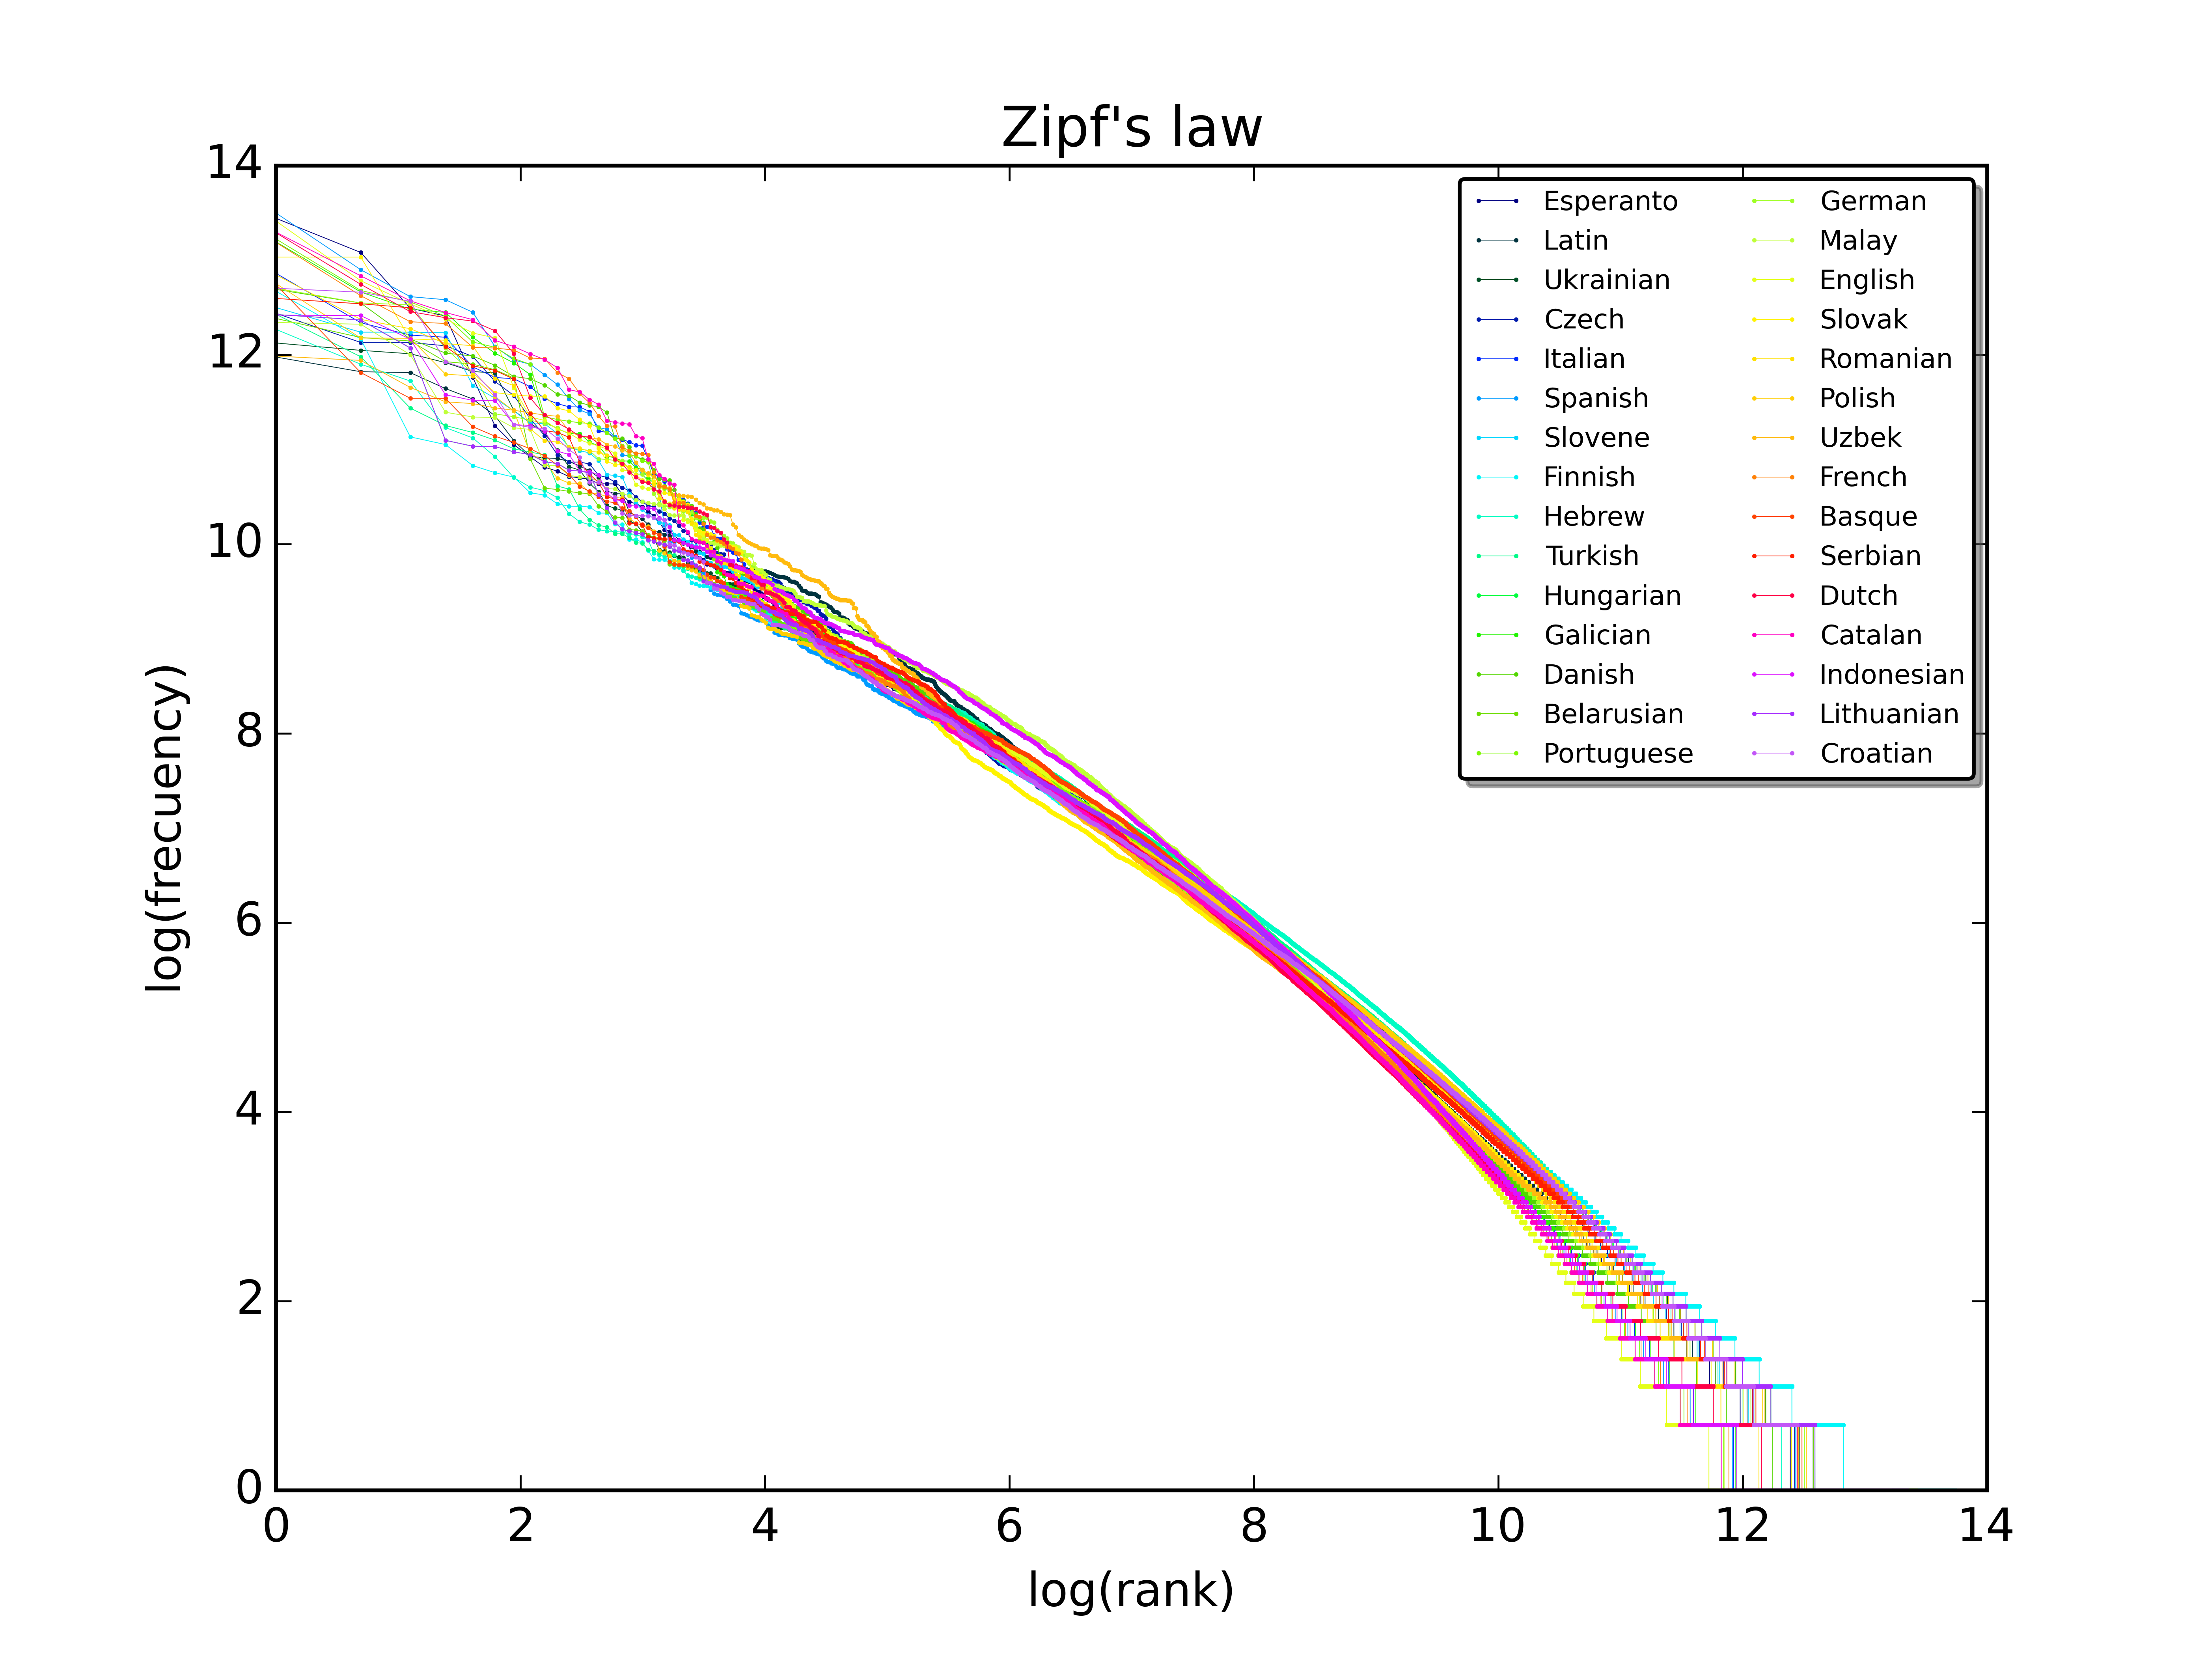

Slide 6
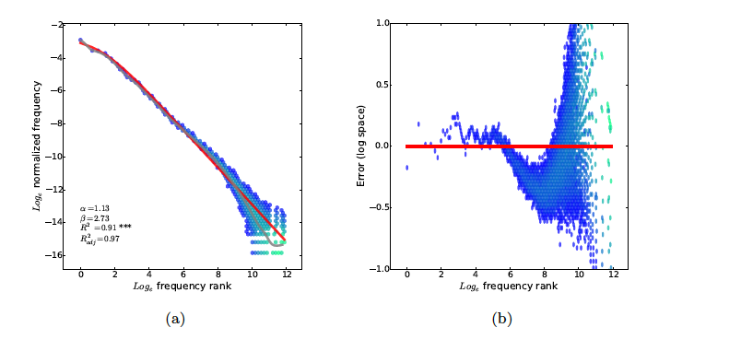
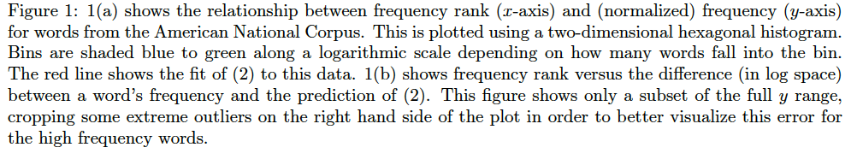

Slide 7
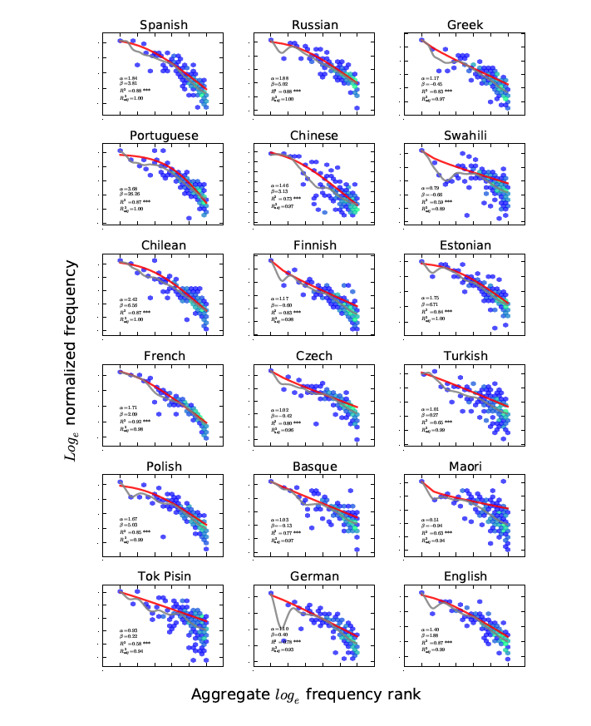

Slide 8
What does Zipf’s law reflect?
Let’s brainstorm:

Slide 9
What does this tell us?
Everything (no one has made this claim)
Communicative efficiency shapes language
  Lots of people working within information theoretic frameworks
    Brief example of information in bits
  Shaped by speakers and listeners
Nothing
  Chomsky’s argument from ambiguity
  Miller’s argument from chance

Slide 10
Some arguments for communicative efficiency
Ambiguity
  Piantadosi et al.
    Requires that people implicitly know frequencies
    Requires that people use contexts
    Assumes communicative efficiency requires taking into account mutual effort by speaker and listener
  Do people know frequencies?
  Word frequency effects
  Do people use context?
  Context effects in language processing
  Do speakers care about efficiency?
  Hyper-articulation

Slide 11
Bringing context and frequency together
Frequency and contextual diversity
  CD vs Frequency in low constraint contexts)
    CD wins
  CD vs Frequency in high constraint contexts
    Frequency wins
Why?
  Frequency and CD are estimates of predictability
Are people predictors?
  Predictive processing and learning

Slide 12
Are infants an young children statistical learners?
Saffran, Aslin & Newport (1998)
  Next sequences
What are children doing?
  Passive learning (children as sponges)
  Active learning (children engaged in predictive learning
    Attention is directed towards information that informs internal models

Slide 13
One type of statistic: Transitional Probabilities
Syllable-to-syllable TPs
within a word > between words
“Look at the happy baby”
“Look at the happy kitty”
hap-py > py-bay
py-kit < kit-ty

Slide 14
Artificial ‘language’ consists of concatenated CV syllables
pabikutibudogolatudaropi…
pabiku
tibudo
golatu
daropi

Slide 15
Design: Saffran, Aslin & Newport (1996)
TPs =
Test Items

Slide 16
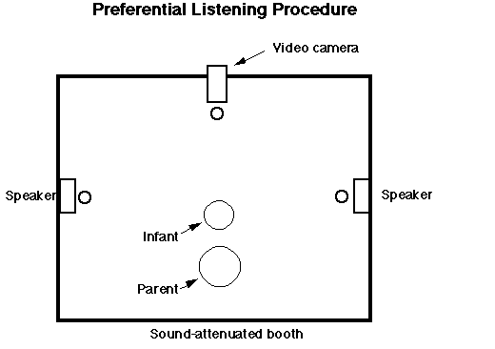
Headturn Preference Procedure

Slide 17
Sequence of syllables: A-B-C-D-E-F-G-H-I-J-K-L . . .
Test triplets: D-E-F vs. I-J-K

Slide 18
Are infants an young children statistical learners?
Saffran, Aslin & Newport (1998)
  Next sequences
What are children doing?
  Passive learning (children as sponges)
  Active learning (children engaged in predictive learning
    Attention is directed towards information that informs internal models

Slide 19
Why are statistical learning and big data important?
Let’s brainstorm…

