Slide 1
Understanding Reading
1/24/2018

Slide 2
Orthography is based on spoken language
Alphabetic orthography
Letter maps onto a phoneme
What’s a phoneme?
Minimal sound unit that can make a meaning difference
pat/bat pill/bill
(voicing)
Where are the phonemes?
The story of speech perception
The lack of invariance
The variability problem
Where are the words?
The story of spoken word recognition

Slide 3
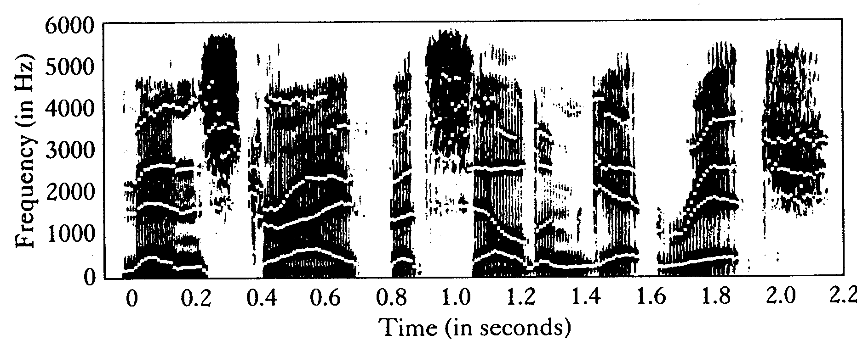
Spectrogram
Men strive but seldom get rich.

Slide 4
Voicing in a Spectogram:
Voicing: differences in Voice Onset Time (VOT)
Small VOT: voiced
Large VOT: unvoiced
Plosion spike (stop) followed by formants (vowel)
[/ka/ - /ga/ continuum]

Slide 5
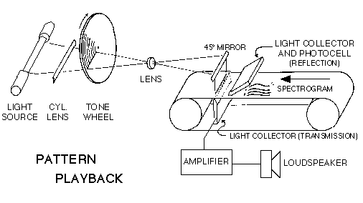
How study speech perception?
Synthetic speech

Slide 6
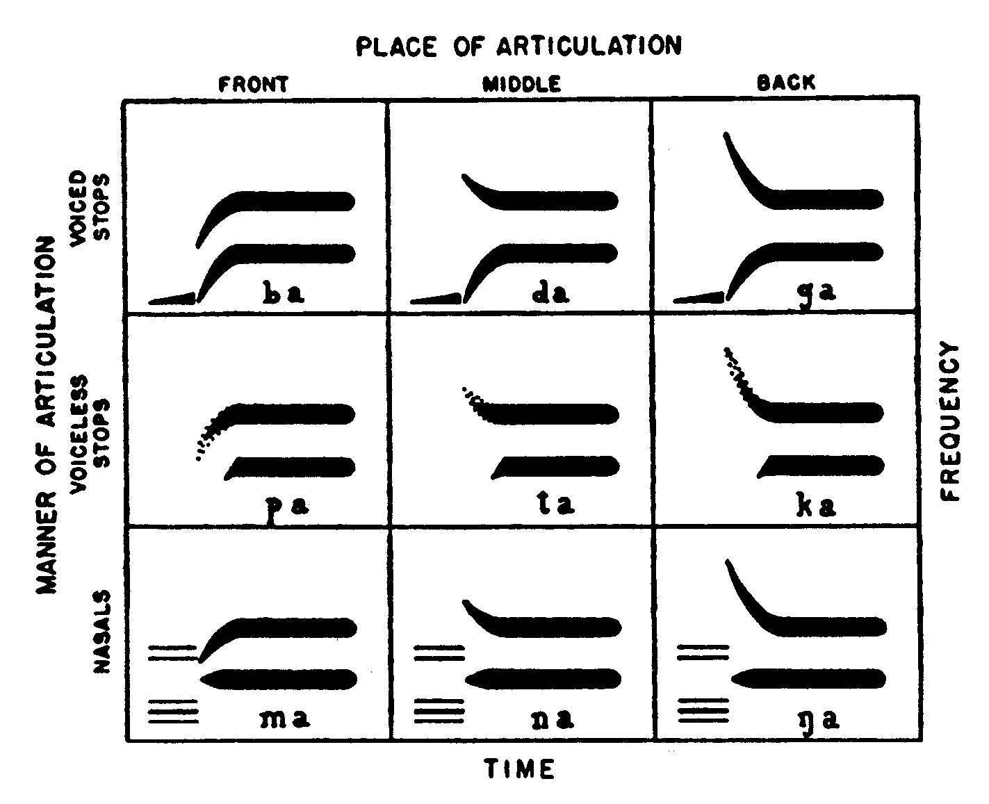
Formant patterns: Synthetic speech

Slide 7
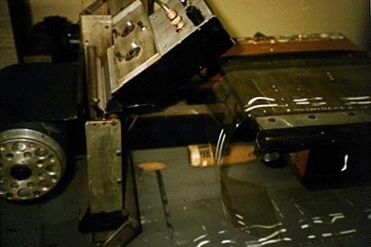
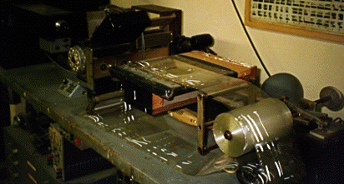
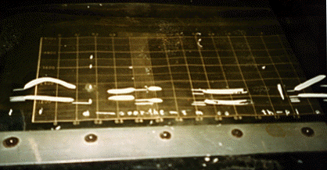
Haskins Labs: Pattern Playback

Slide 8
Pattern Playback

Slide 9
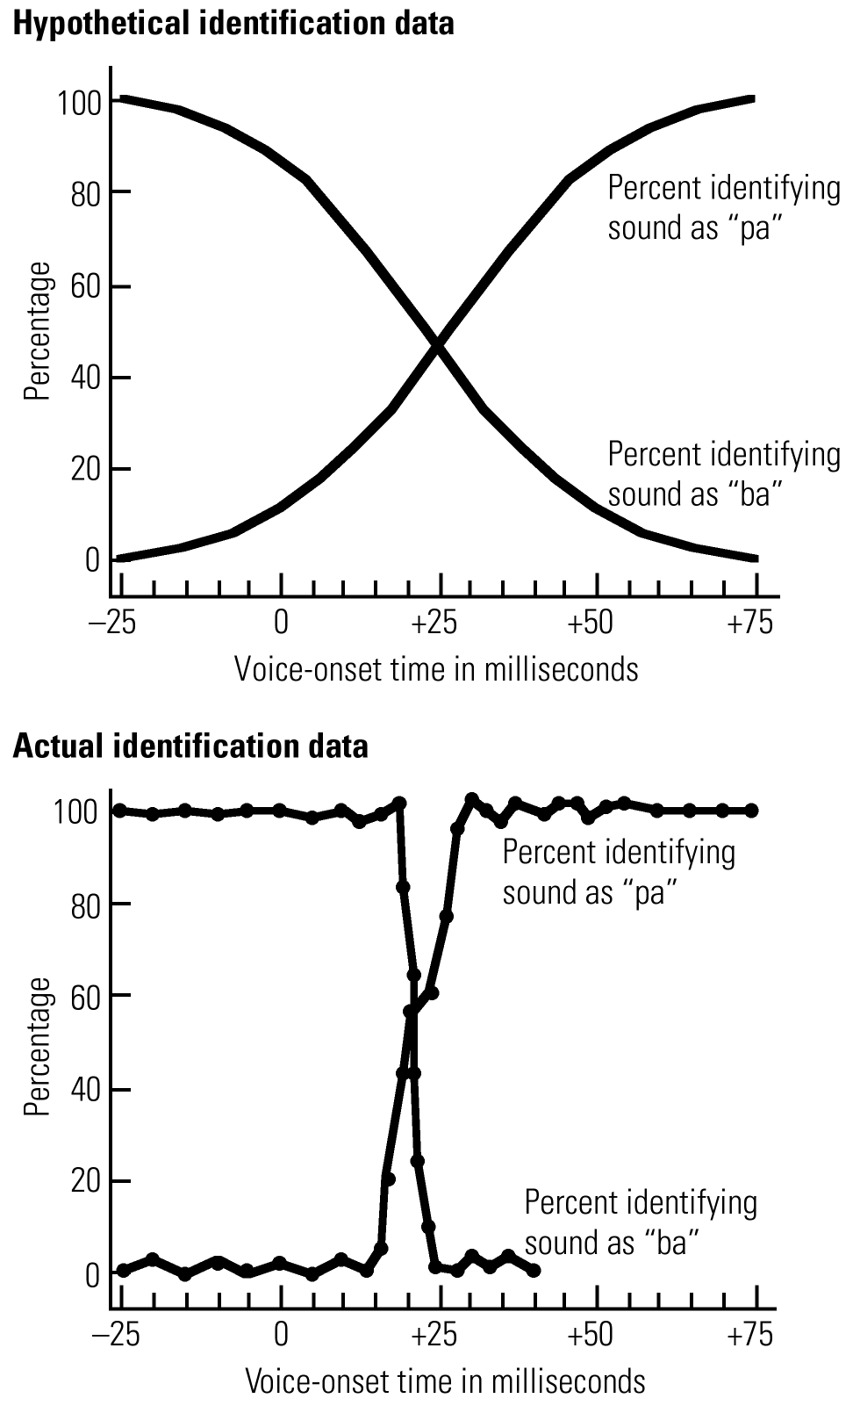
What you might expect

Slide 10
What you actually get

Slide 11
Labeling (identification)
100
/ga/
/ka/
50
0
0 10 20 30 40 50 60 70
Voice onset time (msec)

Slide 12
Discrimination
100
/ga/
/ka/
50
0
0 10 20 30 40 50 60 70
Voice onset time (msec)

Slide 13
Labeling & Discrimination
100
/ga/
/ka/
50
0
0 10 20 30 40 50 60 70
Voice onset time (msec)

Slide 14
Categorical Perception
Pros:
Ignore irrelevant information, compress speech signal into phonological categories
Quickly classify transient events
Cons:
Might ignore useful information (especially, since perception is noisy!)
So, is subphonemic detail really discarded immediately?

Slide 15
But: Categorical Perception of VOT in other species
Chinchillas trained on 0, 80 msec VOT
Test where they perceive a boundary
Chinchillas perceive the same boundary as humans

Slide 16
Speech perception is even more challenging than so far described
Lack of invariance
for segments and for speakers
Sounds can be affected by phonetic context, syllabic stress, prosody & intonation, speaking rate, and emotional state
So imagine reading the text through a blurry, fast-moving lens … and letters are in variety of different fonts

Slide 17
Lack of invariance
Realization of phonological categories can be affected by phonetic context, syllabic stress, prosody & intonation, speaking rate, and emotional state
Same talkers realize same phonological categories differently

Slide 18
Variability: phonological contexts
Sounds are not produced out of context: sounds surrounding a phoneme influence its realization ←co-articulation
→ One reason why synthesized speech often sounds unnatural

Slide 19
Coarticulation
Co-articulation: adjust pronunciation of current sound to take into account preceding and following sounds
kill vs. cool
Can you describe the difference in the position of your articulators during the /k/ production of these two words?

Slide 20
Spoken word recognition
Recognition problem

Slide 21
Spoken word recognition
Segmentation problem:
Spoken words unfold as a series of transient acoustic events extending over a few hundred ms, without reliable cues to word boundaries.
Imagine reading this page through a two-letter aperture, the text scrolling past without spaces separating the words, at a variable rate you can’t control, with the visual features for each letter arriving asynchronously.

Slide 22
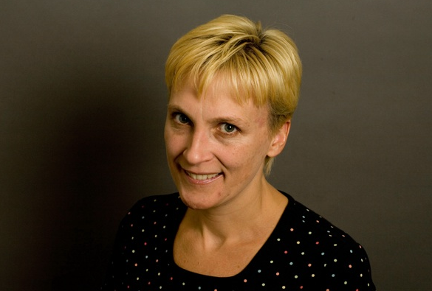
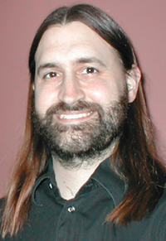
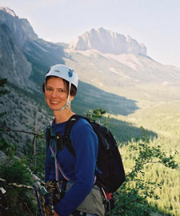
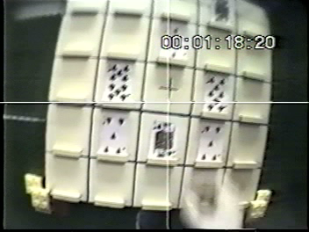
Eye movements and spoken language
Kathleen Eberhard
Notre Dame
Michael Spivey, Merced
Julie Sedivy
Brown
Put the five of hearts that’s below the eight of clubs above the three of diamonds

Slide 23
Visual World Eye Tracking
Put the five of hearts that’s below the eight of clubs above the two of diamonds

Slide 24
Put the five of hearts that’s below the eight of clubs above the two of diamonds

Slide 25
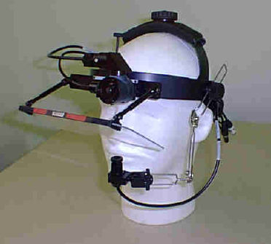
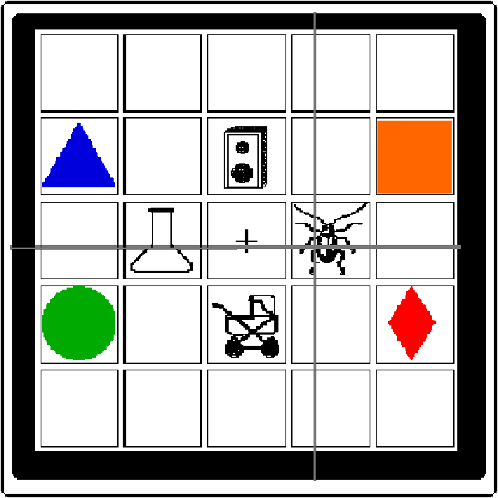
Allopenna, Magnuson & Tanenhaus J. Memory & Language (1998)
Eye camera
Scene camera
Pick up the beaker

Slide 26
Fixation Proportions over Time
Trials
1
2
3
4
5
+
Time
200 ms
Target = beaker
Cohort = beetle
Unrelated = carriage
Proportion of fixations
Look at the cross.
Click on the beaker.
Time

Slide 27
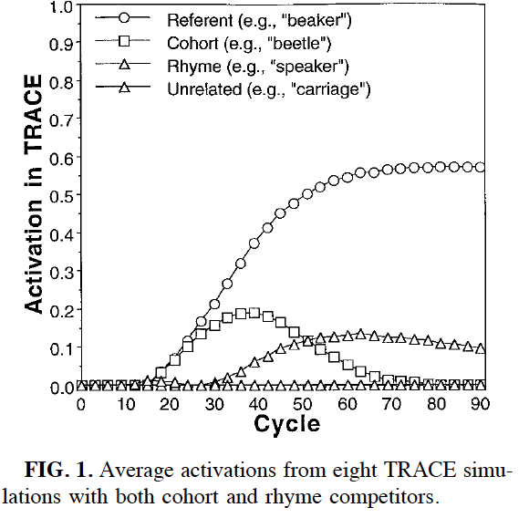
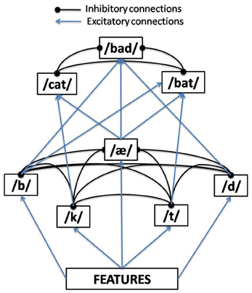
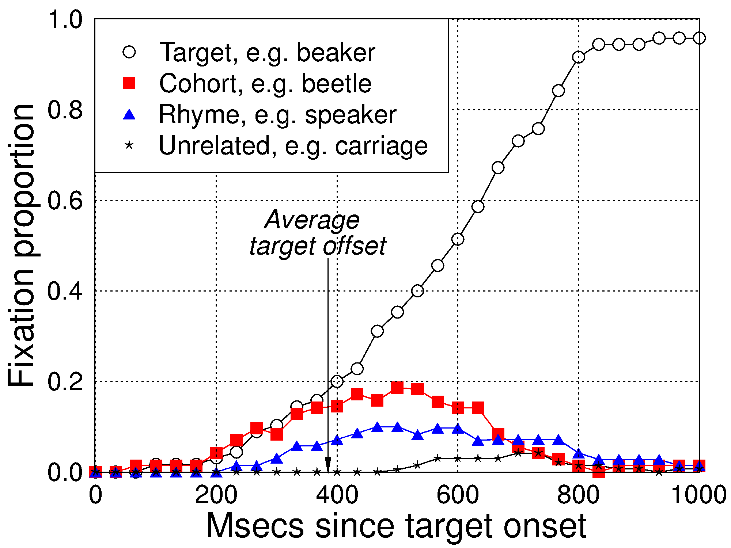

Slide 28
Allopenna et al. results

Slide 29
Factors That Affect Spoken Word Recognition
Quality of the signal
More noise, slower, less accurate recognition
Frequency of occurrence
Higher frequency words recognized faster*
(violin vs viola)
Context
Faster “recognition” and biases from context
Competitors
More candidates, slower recognition

Slide 30
Subphonetic detail in spoken word recognition
0.08
Response=
Response=
0.07
0.06
Looks to
Fixation proportion
0.05
Looks to
0.04
Category
Boundary
0.03
0.02
0
5
10
15
20
25
30
35
40
VOT (ms)
McMurray, Tanenhaus & Aslin Cognition(2002)

