Slide 1
Eye movements in reading
An introduction to eye movements

Slide 2
What does it feel like when you read?
Please read the text on this slide and then be prepared to explain what you are seeing and what your eyes are doing as you read. How many words do you think you can see clearly on each line? Answer based on what you experience not what you know from reading Seidenberg or from other courses.

Slide 3
Some examples
Speed reading YouTube

Slide 4
Some examples
Eye movement reading videos

Slide 5
Types of eye movements
Pursuit:
  Smooth movements when tracking a moving object
Saccades:
  Rapid, ballistic shifts in fixation.

Slide 6
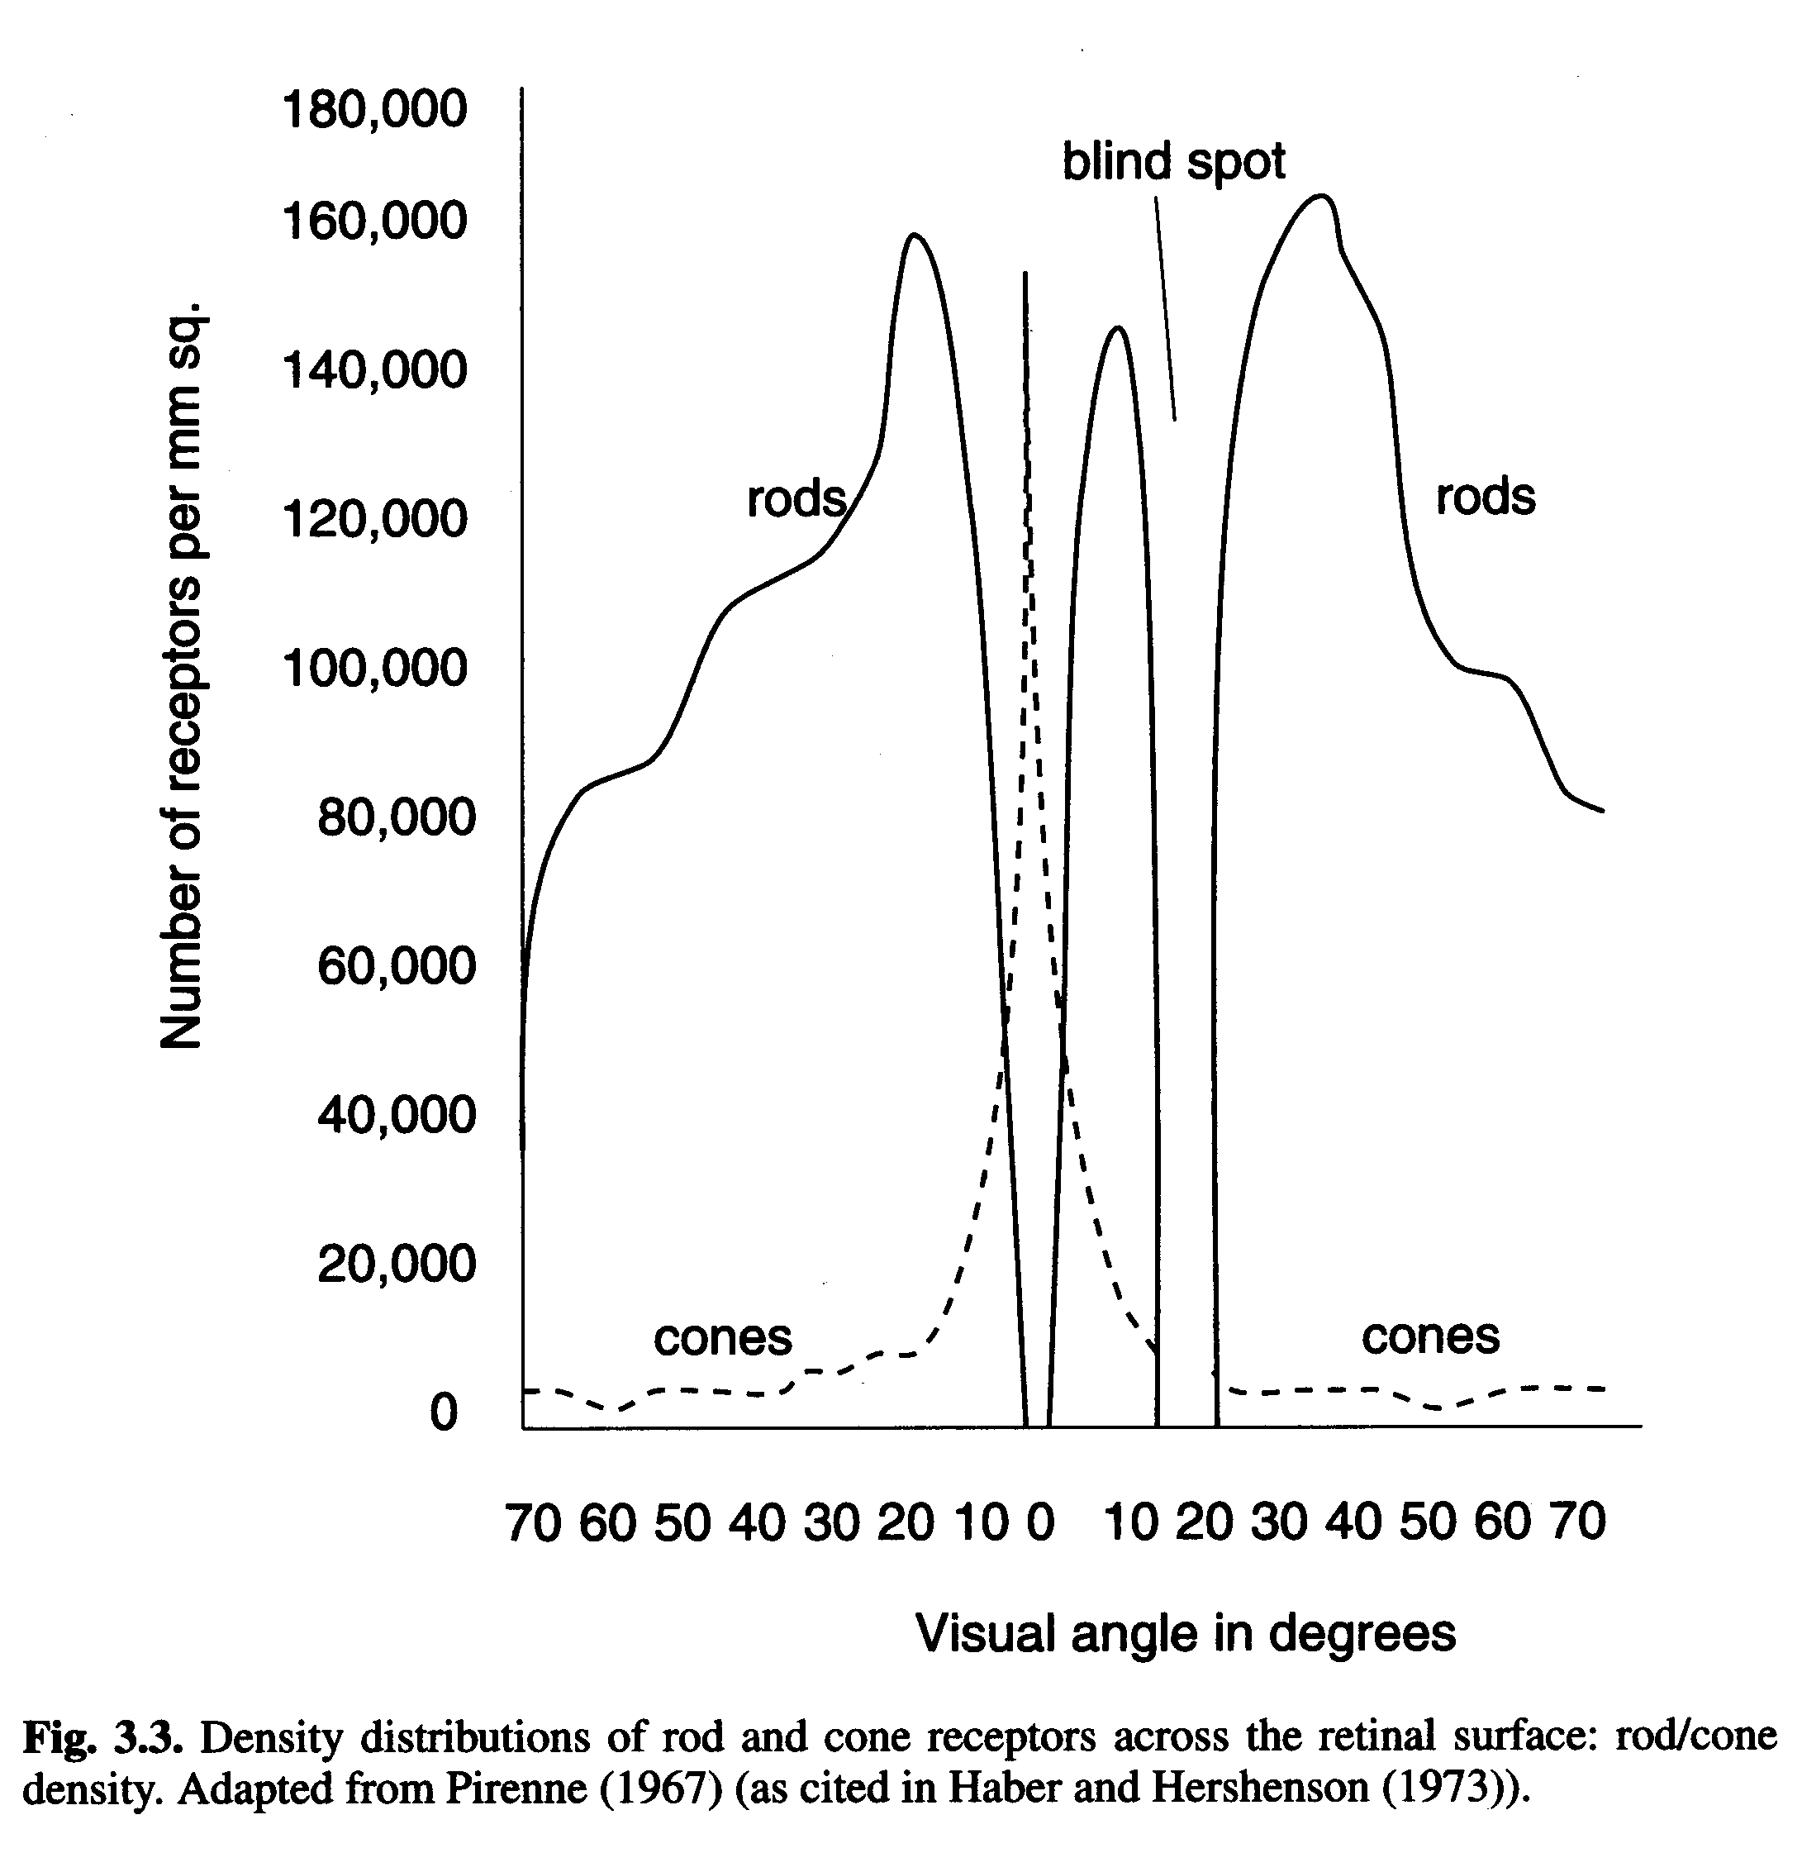
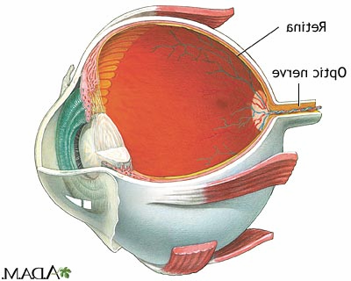
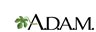
Why are there eye movements?
Fovea
Retina
Optic Nerve
cones

Slide 7
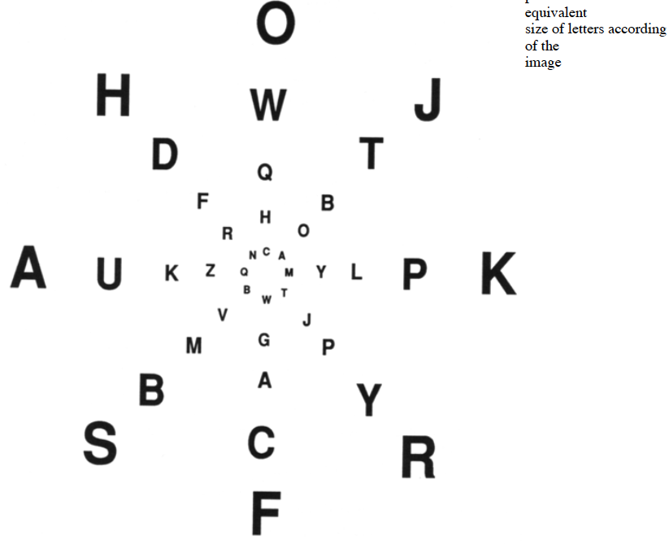

Slide 8
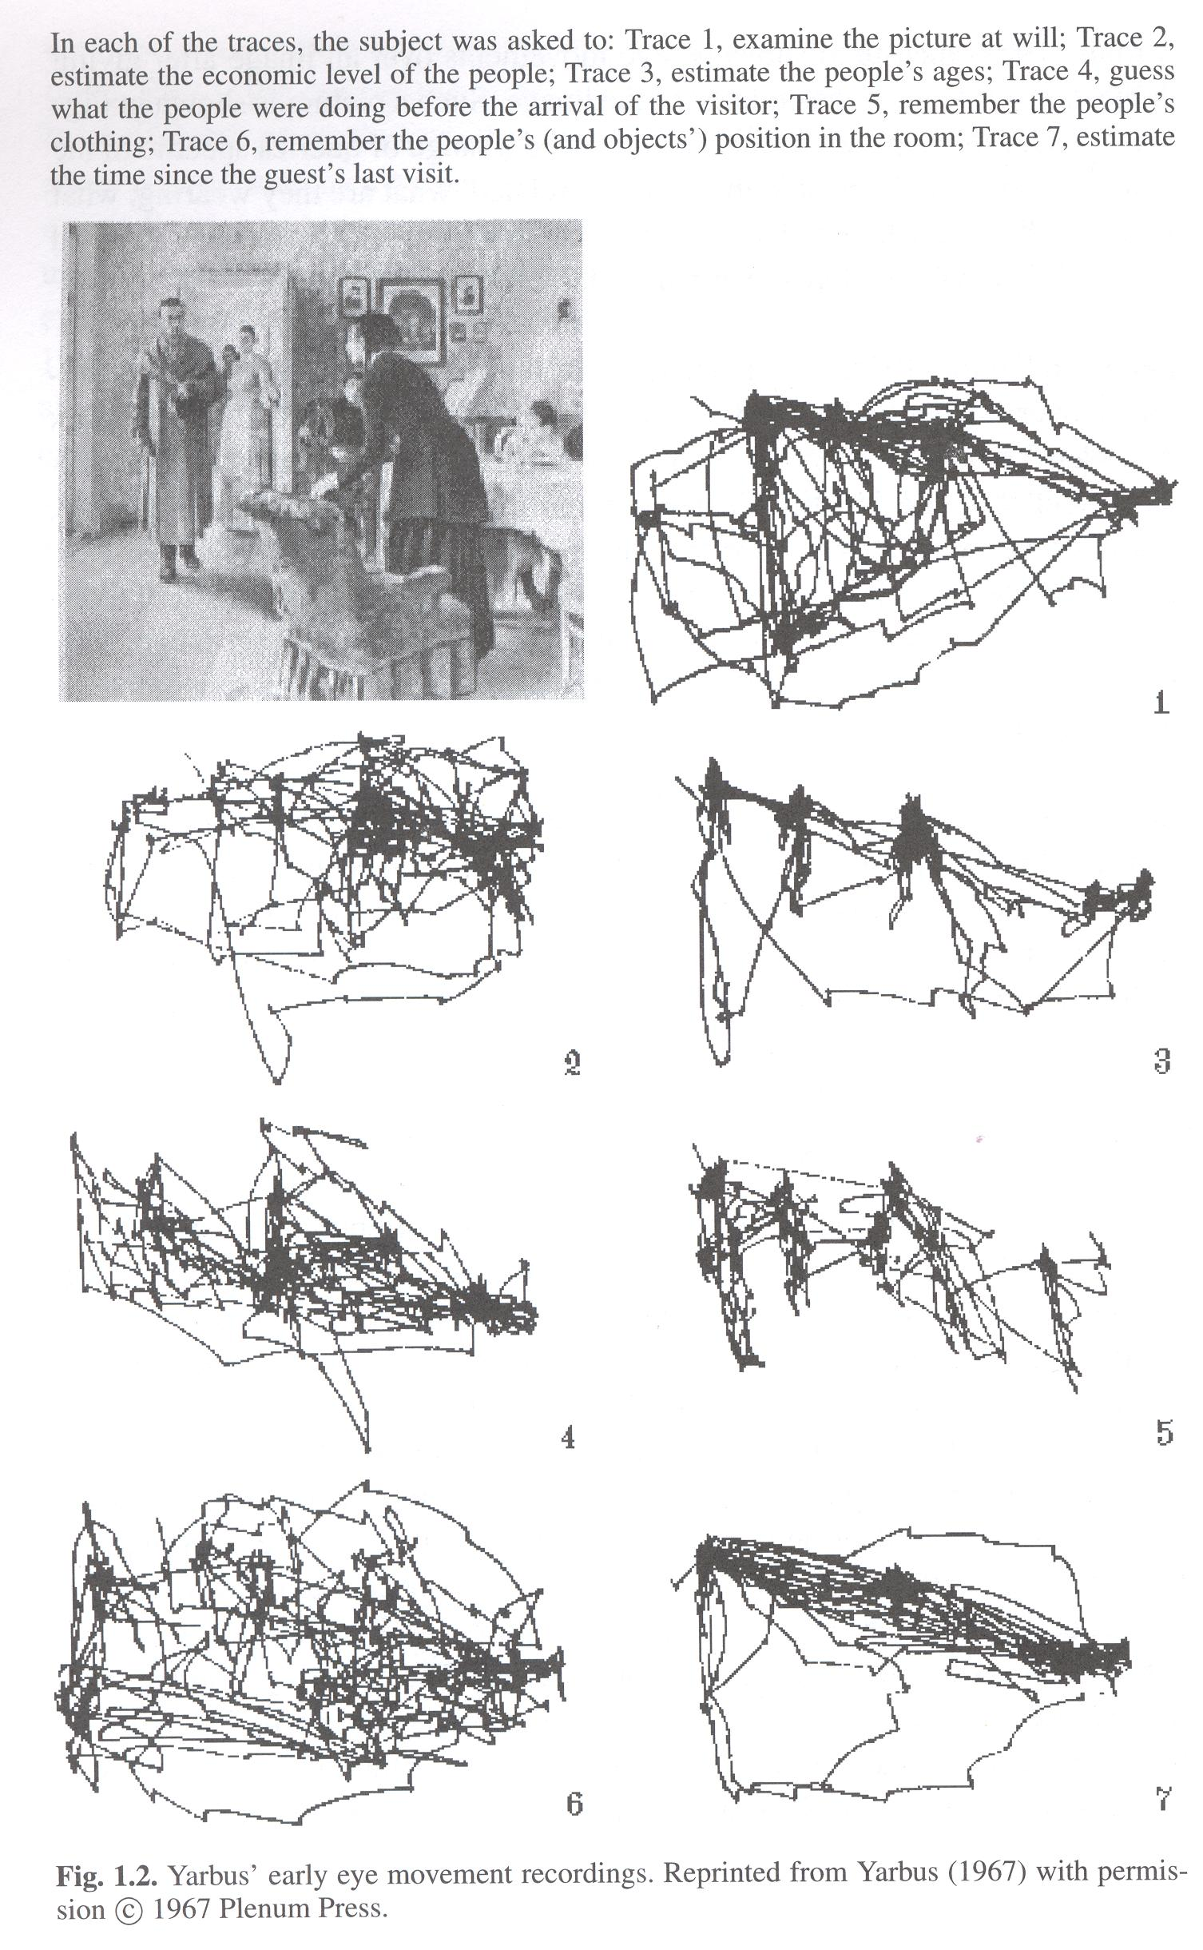
Why study eye movements?
To follow the observer’s path of attention.
  What draws attention.
  What was of interest to the observer.
  How the observer perceived scene.
Yarbus (1967)
Notes:
Explain what fixations and saccades and smooth pursuit are…

Slide 9
Eye movements (attention) depend on goals.
  Consider how your goals affect your eye movements…

Slide 10
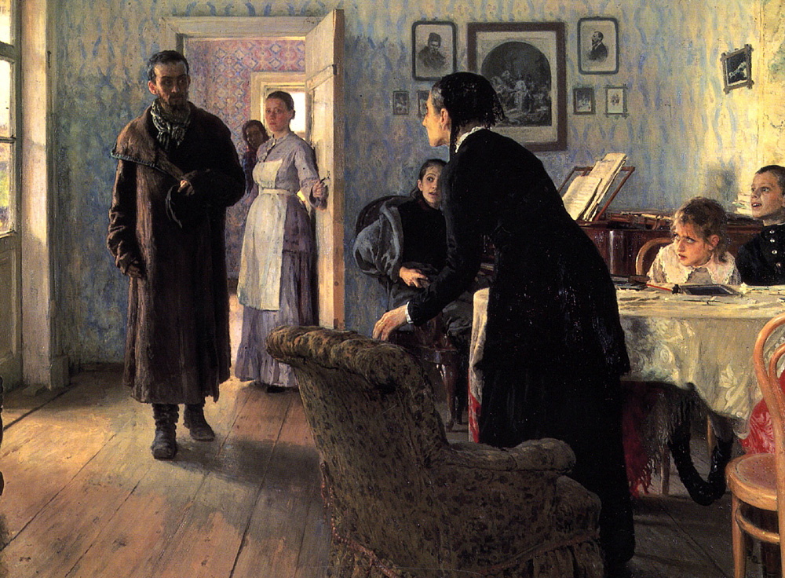
Repin’s Unexpected Visitor
To which economic class does each person belong?
How old would you say each person is?
How long do you think he’s been away?

Slide 11
Yarbus (1967)
Examine picture at will.
Estimate economic status.
Estimate ages.
Guess what people were doing before arrival of visitor.
Remember people’s clothing.
Remember position of people and objects.
Estimate time since guest’s last visit.

Slide 12
Important implication for what draws our attention:
Exogenous (stimulus) factors.
  Parallel saliency maps?
Endogenous (goal/memory) factors.
  Parallel relevancy maps?

Slide 13
William James basically had it right.
Everyone knows what attention is. It is the taking possession by the mind, in clear and vivid form, of one out of what seem several simultaneously possible objects or trains of thought. Focalization, concentration, of consciousness are of its essence. It implies withdrawal from some things in order to deal effectively with others.
  William James, Principles of Psychology,1890

Slide 14
Under this view, a person is never a passive viewer…
So let’s ask the question again:
Why study eye movements?
  To understand:
    How people interact with the world.
    How people manipulate, interrogate, visual world to meet their goals.

Slide 15
But…isn’t the primary goal of a perceiver to get a detailed representation of the scene as a whole?
Classic passive-viewer answer: Yes.
  Attention allows us to sample the world to build up a detailed internal visual representation of our surroundings.
    Serial sampling of world leads to incremental construction of a detailed image.

Slide 16

Sequential Sampling of Visual World

Slide 17

Sequential Sampling of Visual World

Slide 18

Sequential Sampling of Visual World

Slide 19

Sequential Sampling of Visual World

Slide 20

Sequential Sampling of Visual World

Slide 21

Sequential Sampling of Visual World

Slide 22
Final Internal Representation
But if a high-quality internal representation is built up, it should be trivial to detect a subsequent change in that image.

Slide 25
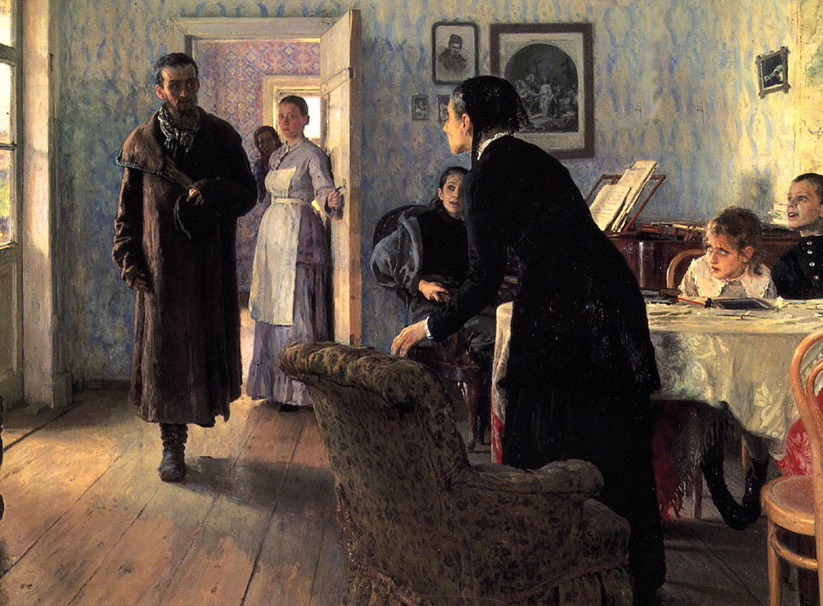

Slide 26
Now we’ll make it easy to see the change.

Slide 29
One interpretation of
‘change blindness’
People use the visual world as their ‘memory for details’.
  For the most part they only hold the spatial layout of their immediate environment in ‘internal’ memory.
  People assume that the properties of most objects do not change suddenly.
The result is that eye movements serve as dynamic access to an ‘external memory’.

Slide 30
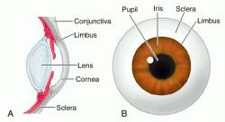
Measuring Eye Movements
“Barlow photographed a droplet of mercury placed on the limbus. Translations of the head were minimized by having subjects lie on a stone slab with their heads wedged tightly inside a rigid iron frame”
      Kowler, 1990

Slide 31
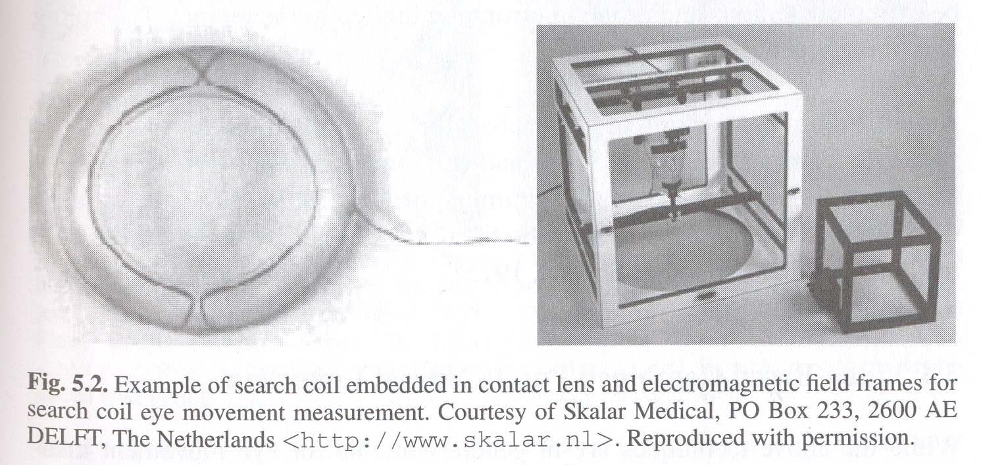
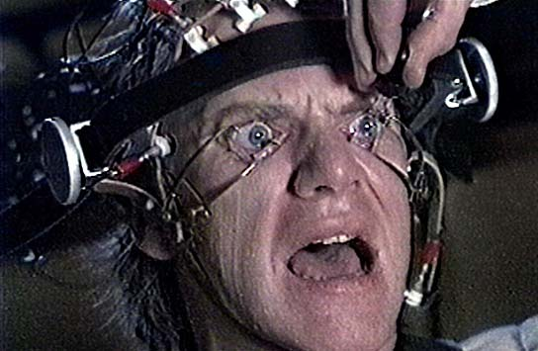
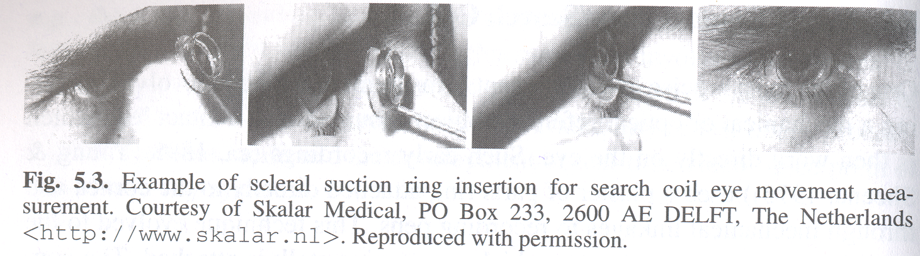
Sclerel Eyetrackers
From “Clockwork Orange”

Slide 32
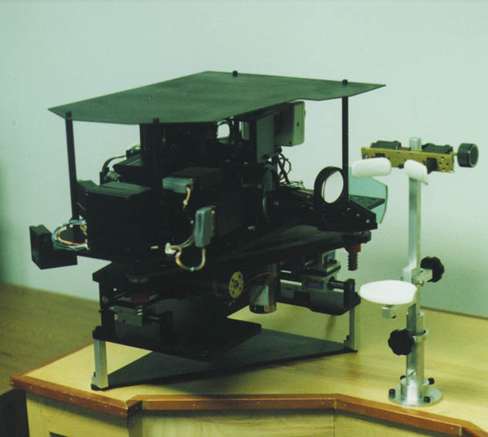
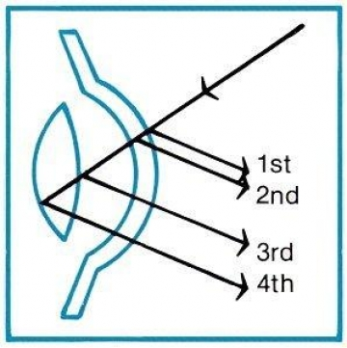
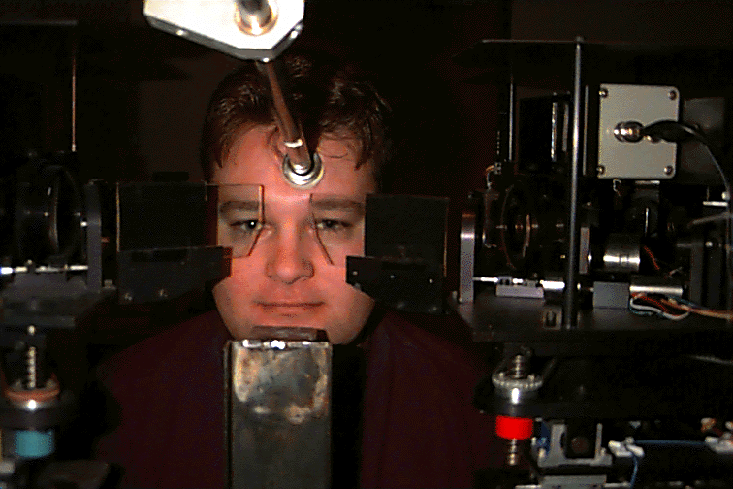
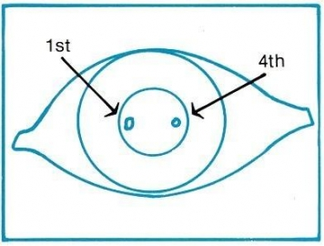
Dual Purkinje Eyetrackers

Slide 33
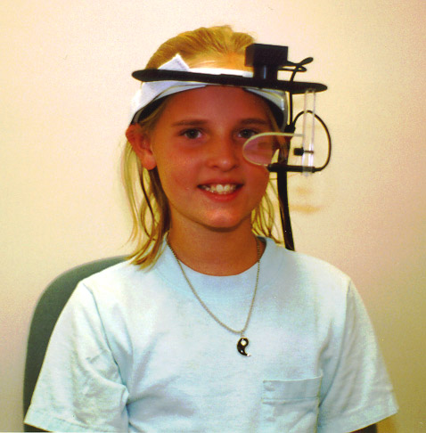
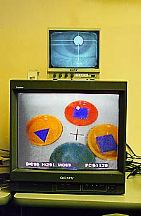
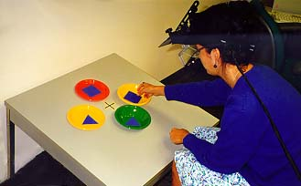
Video-based visor eye trackers

Slide 34
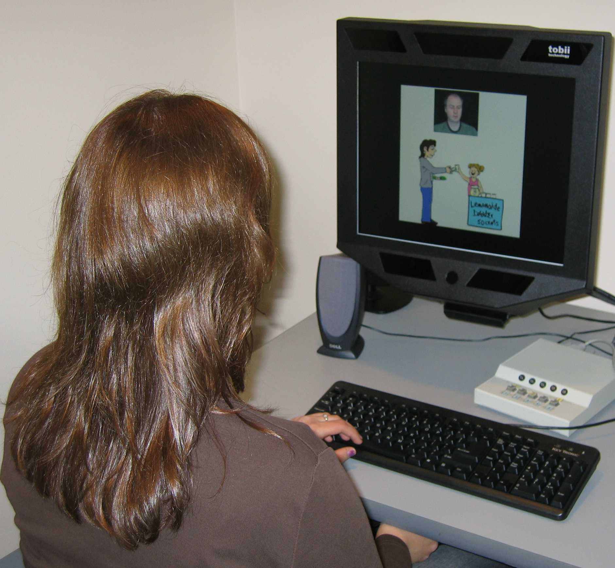
Remote Eyetracker

Slide 35
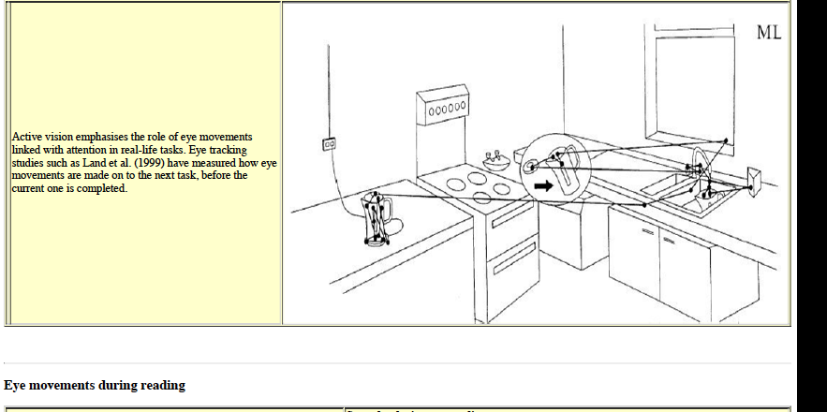

Slide 36
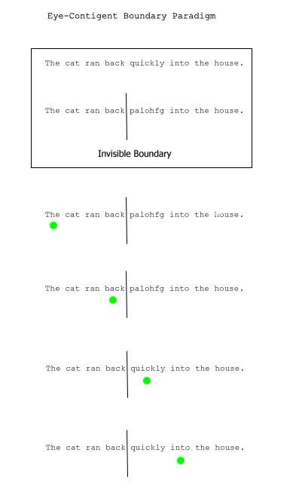
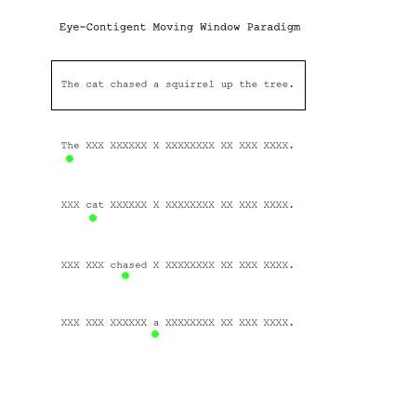
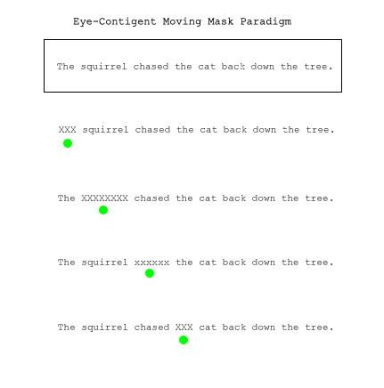

Slide 37
Eye-Movement Parameters
Saccade latency: 150-175 ms;
Perceptual span: ~4 symbols to the left, ~15 symbols to the right;
Skipping words: 2-3-letter words are skipped 75%, 8-letter words are never skipped;
Regressions: 10-letter spaces happen because of problems in understanding text

Slide 38
Eye Movements and Word Recognition in Reading
Word frequency
Word familiarity
Age of acquisition
Number of meanings
Morphology
Predictability
Plausibility

